Slide 1
MCC spatial clustering and deconvolution
3/30

Slide 2
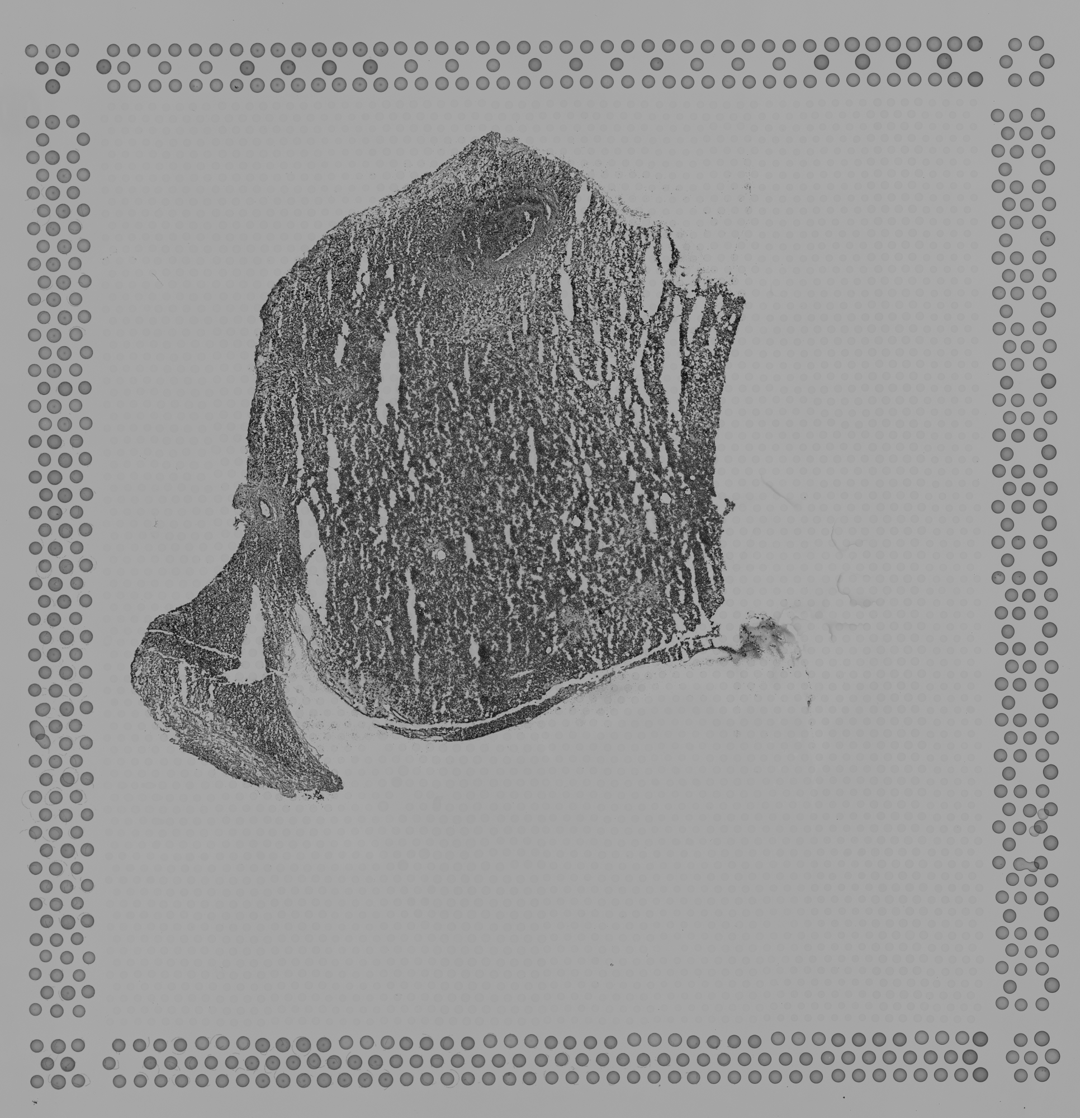
Sample 044_A

Slide 3
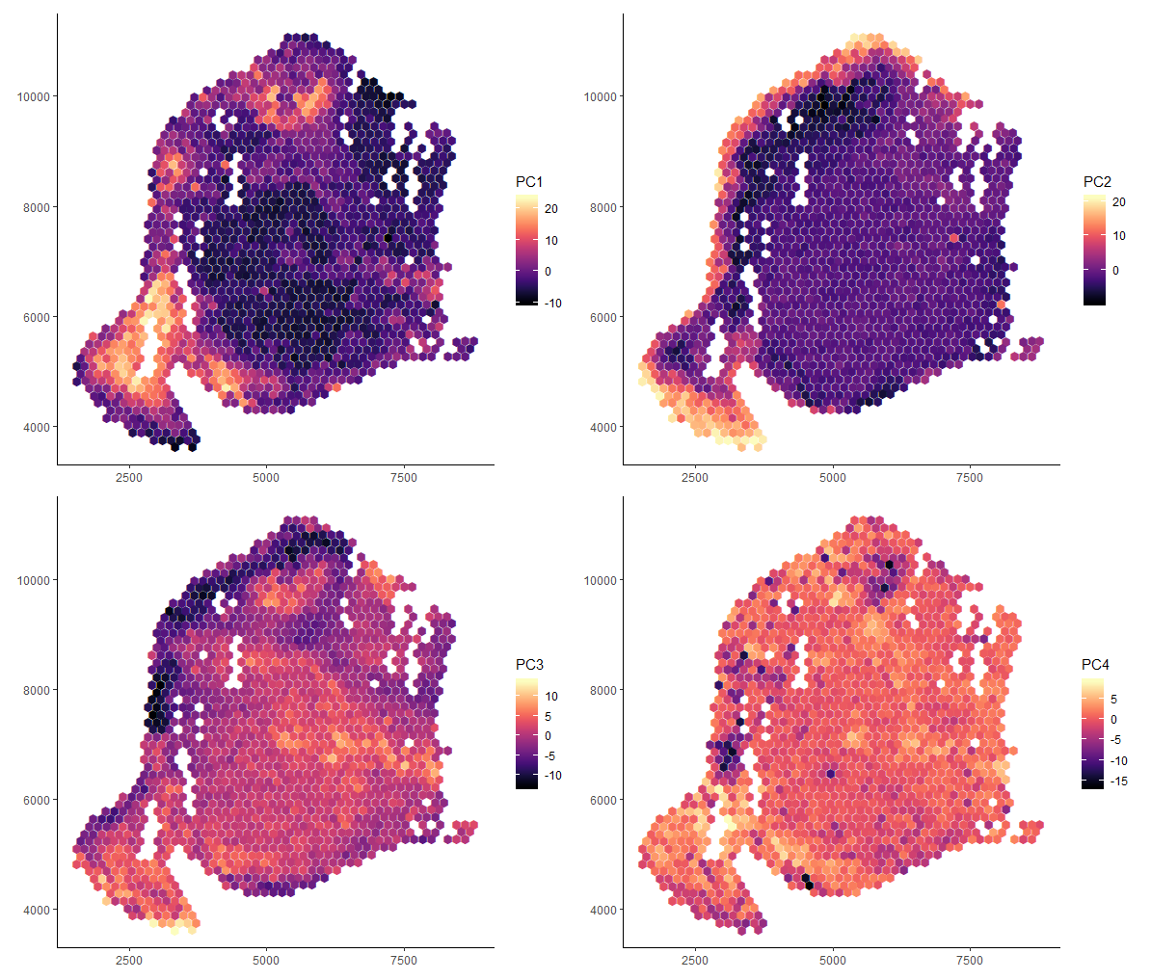
First 4 PCs: actual data

Slide 4
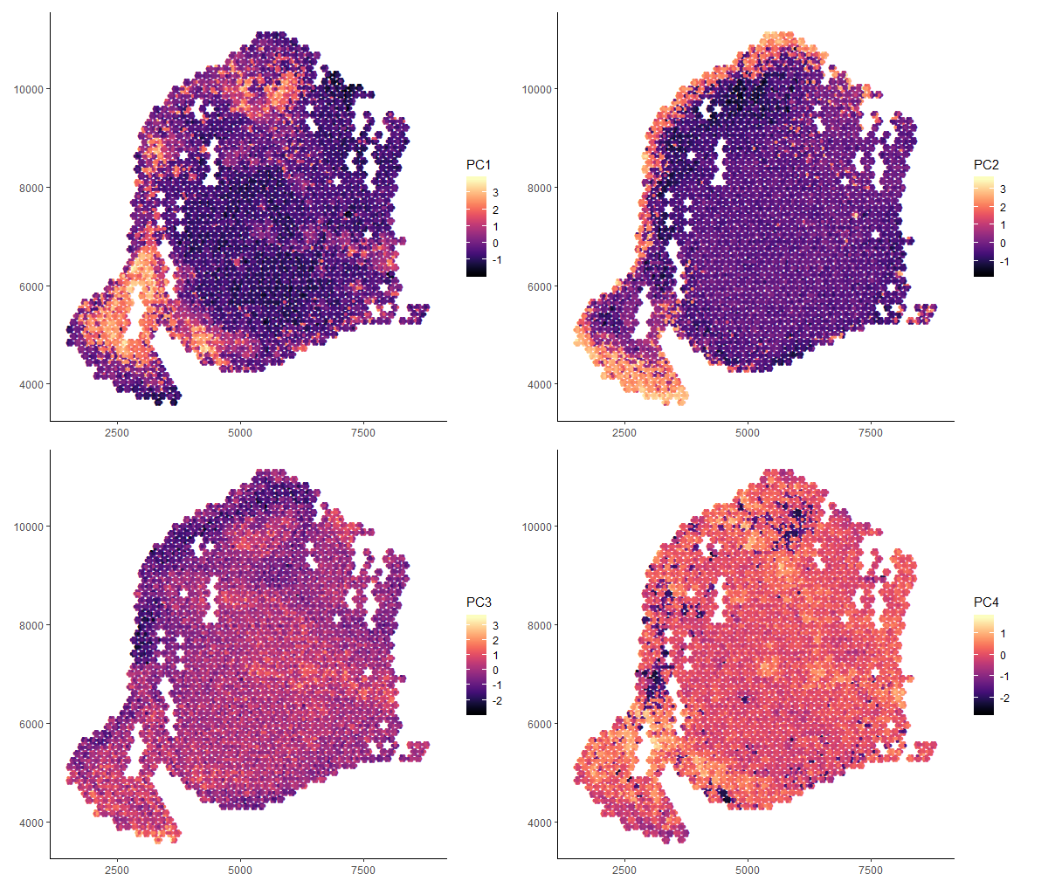
First 4 PCs: deconvolution

Slide 5
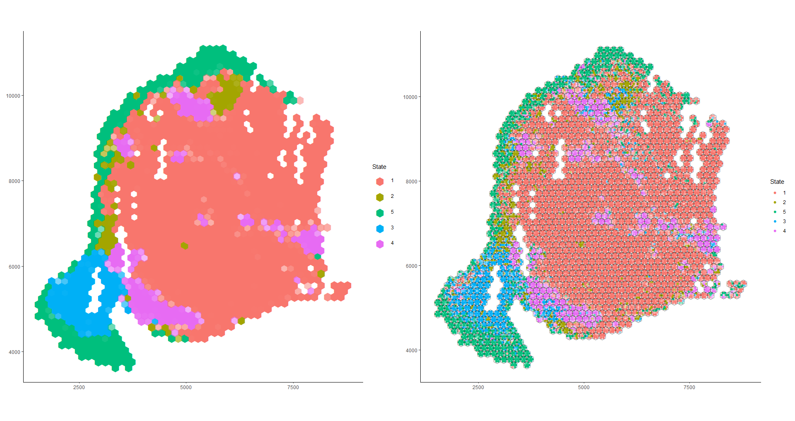
Clustering Deconvolution

Slide 6
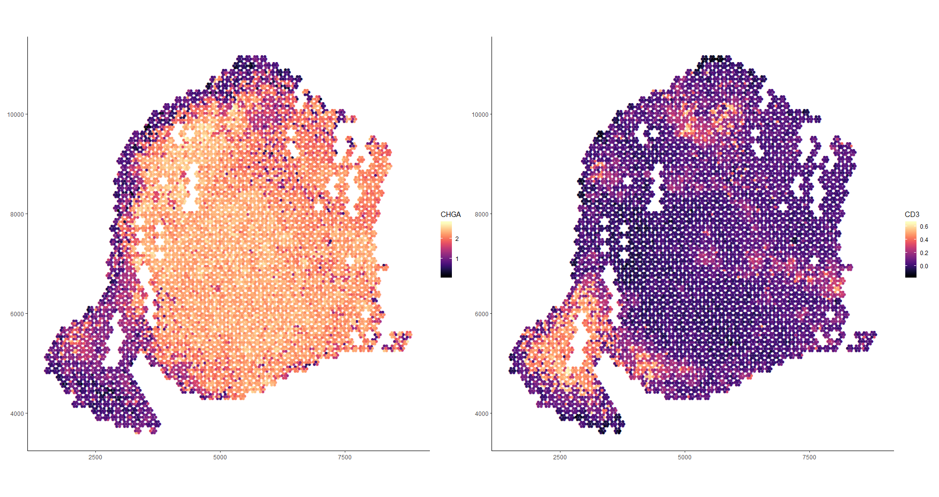
Predicted gene expression from top PCs

Slide 7
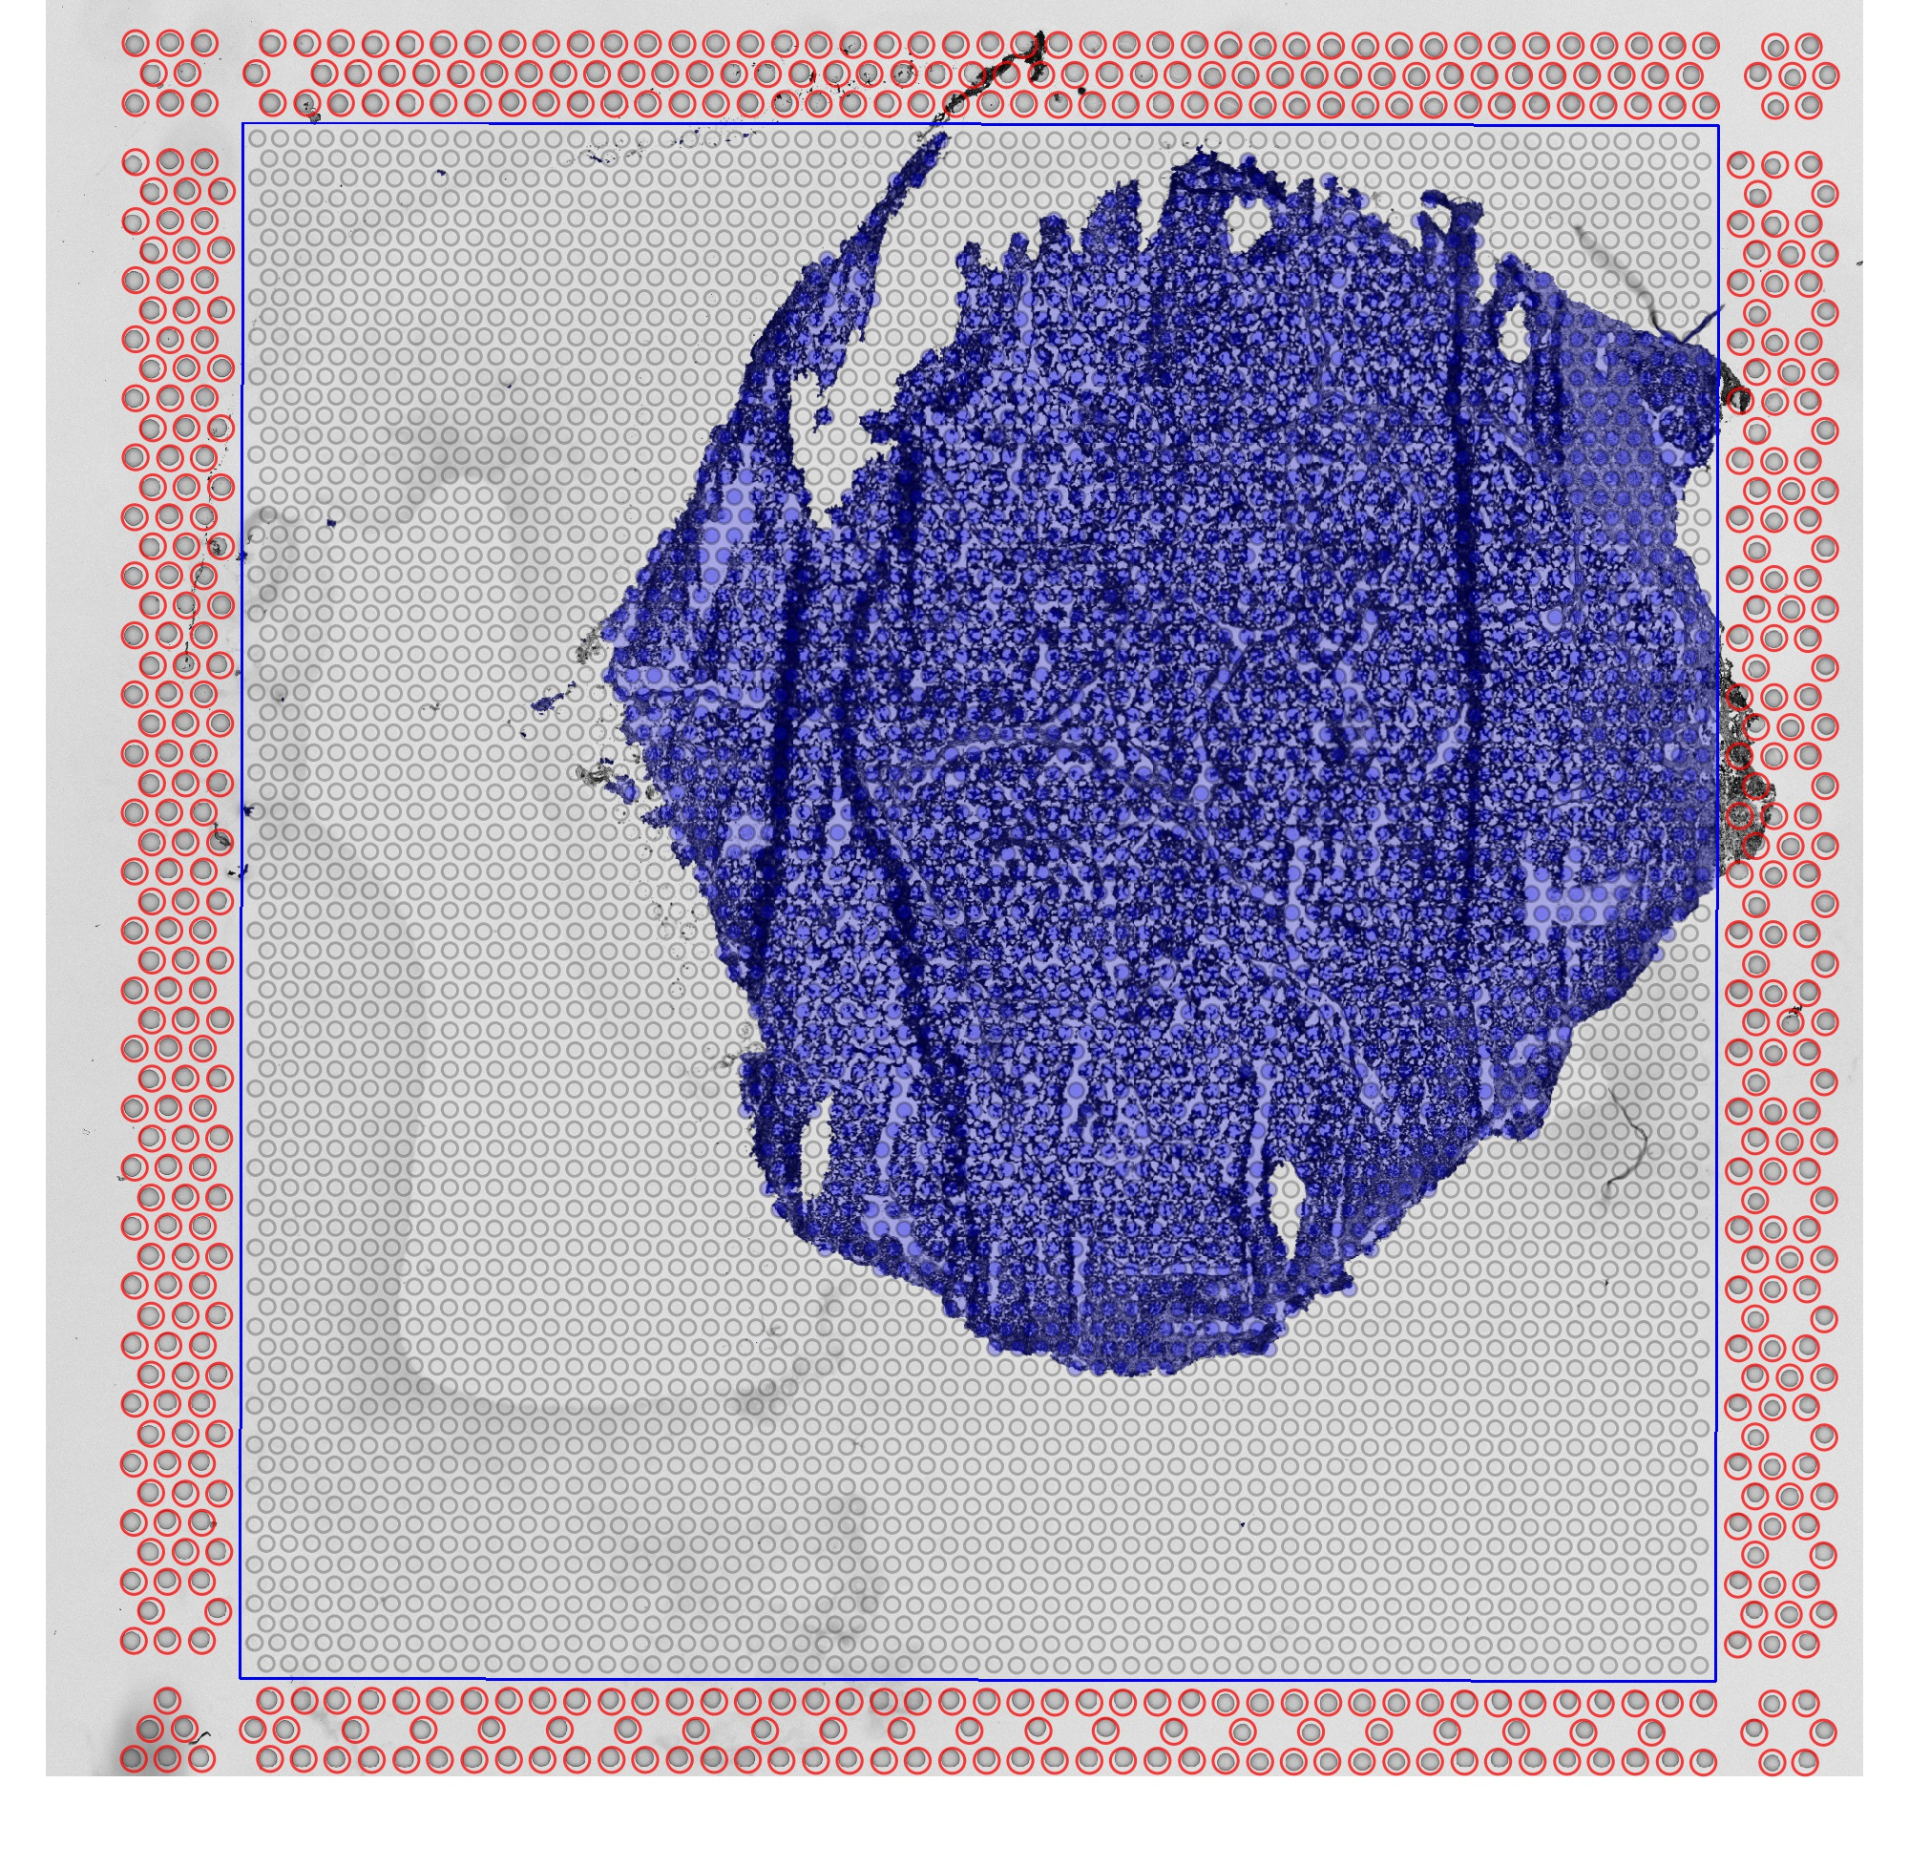
Sample 017_A

Slide 8
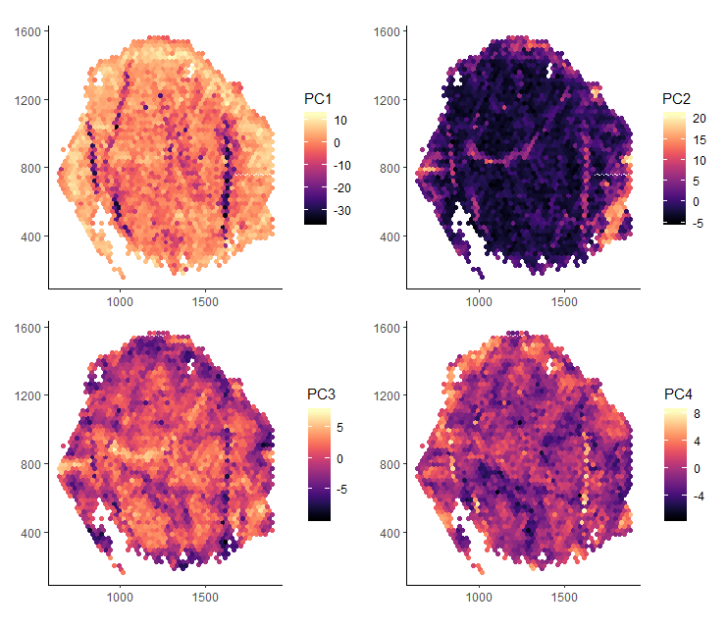
First 4 PCs: actual data

Slide 9
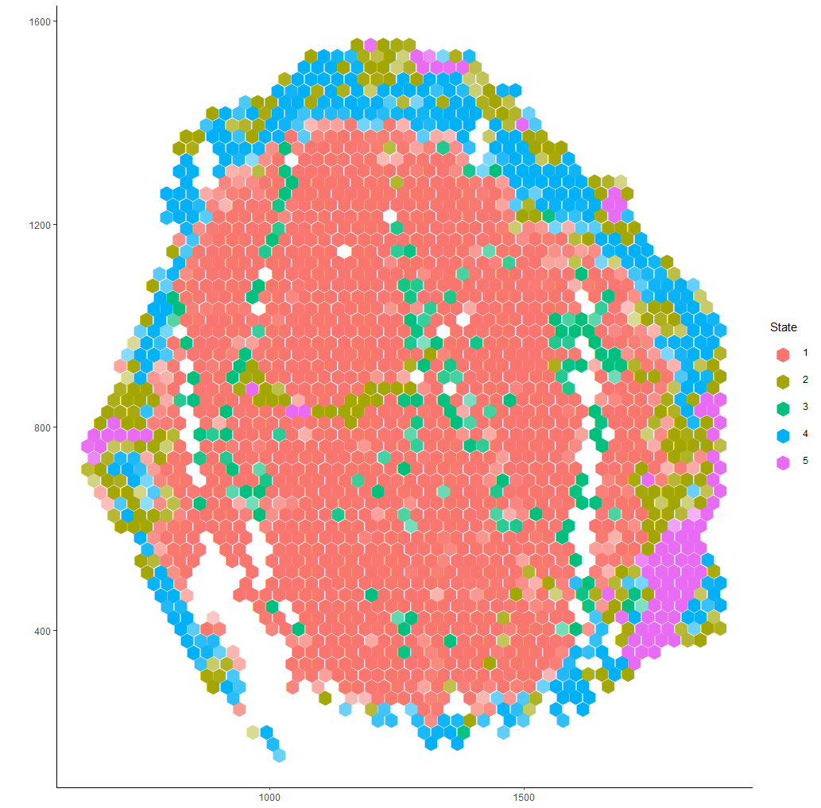
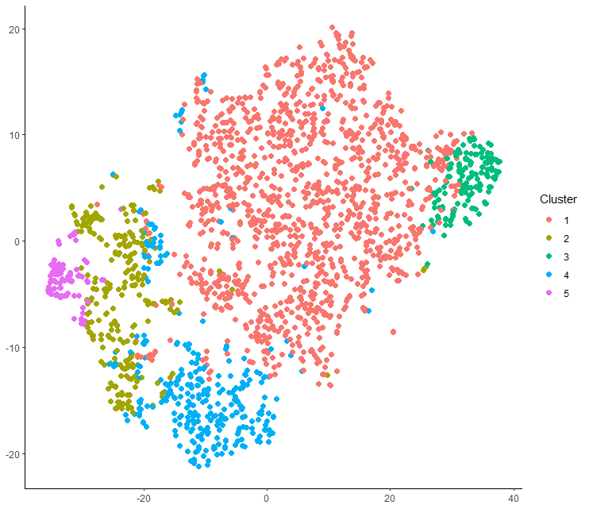
TSNE and clustering

